Slide 1

Data-Driven Approach to Variational Synthesis of Mechanisms
Shrinath Deshpande

Slide 2
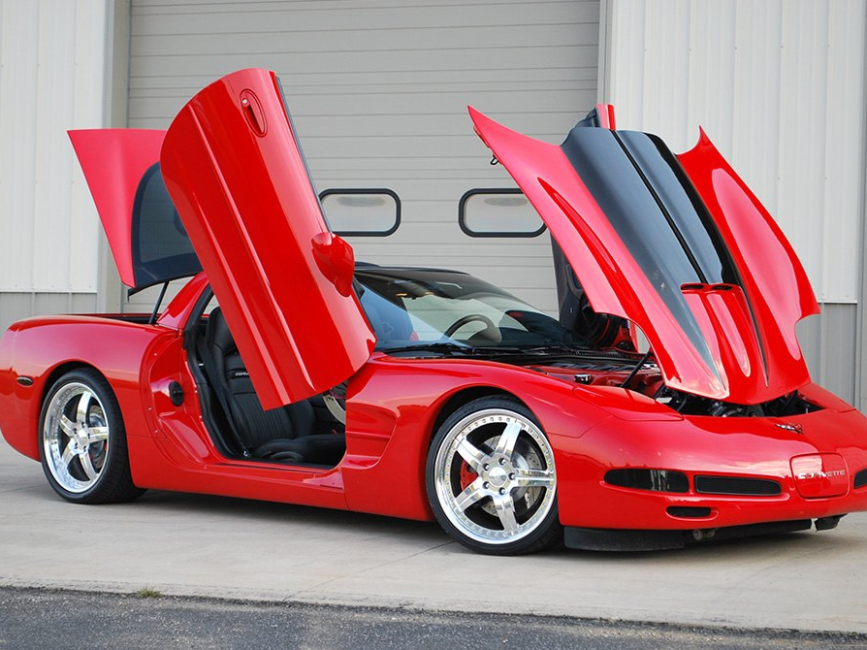

Slide 3

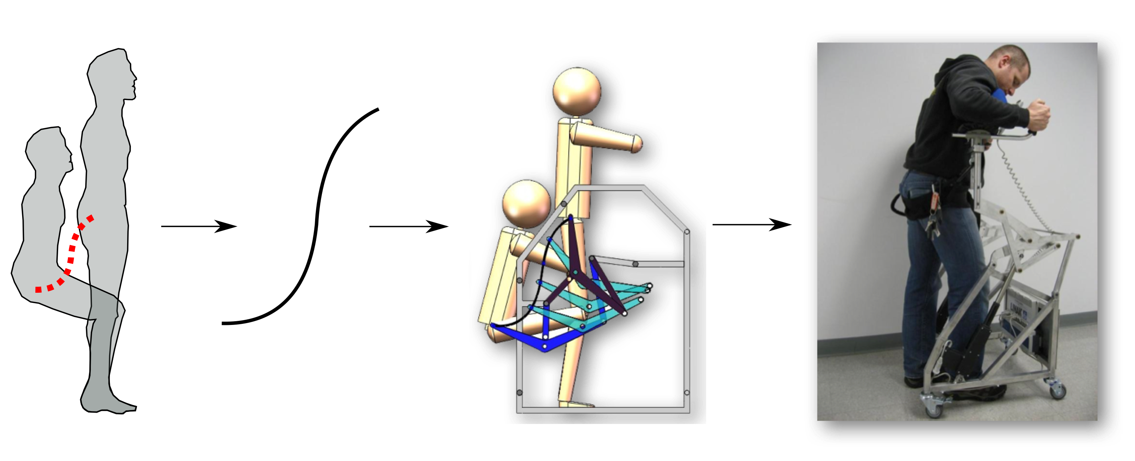
Machine Design Process
Problem
Task for
Synthesis
Solution
Design
Prototype
Mechanism Design

Slide 4
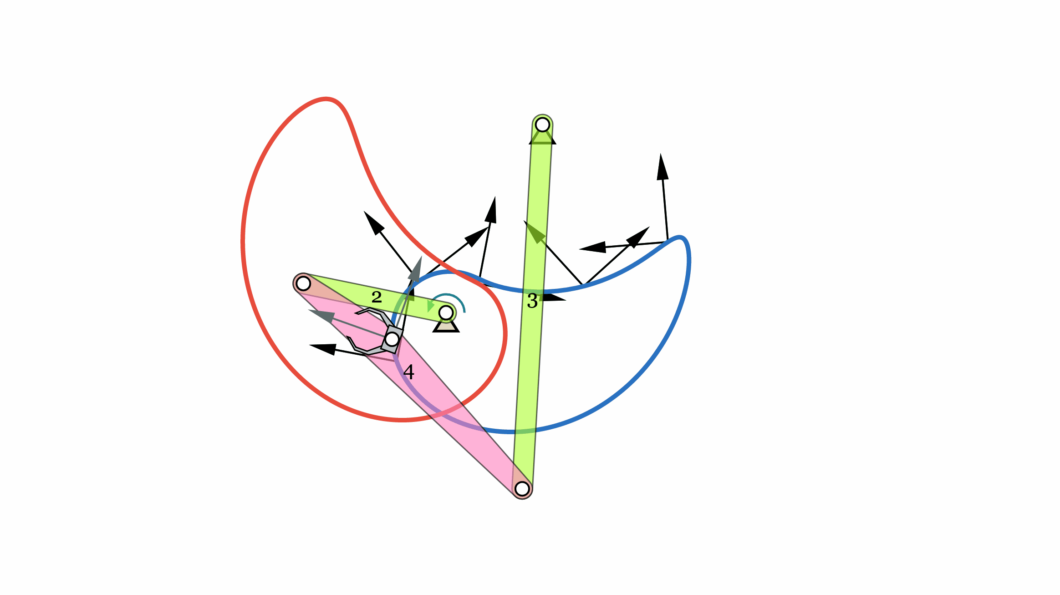
Motion Generation : Classical Burmester Problem

Slide 5
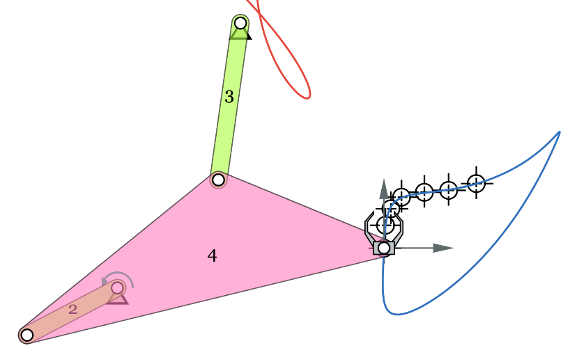
Path Generation

Slide 6


Mechanism Design
Problem Solving
Problem Setup
Requires Understanding
the task and solver needs
Computational Solver
Representation
Suitable for Solvers
Task of Moving Hip
From Sit to Stand
In Natural Motion

Slide 7
Mechanism Design
Active topic in research since past 4 decades
Discovery of various geometric and computational methods
Focus was on theoretical aspects of the problem prevalent in Academic Setting
Available tools require expert user to get useful results

Slide 8
Reasons for Unavailability of Commercial Tools
Susceptible Synthesis Solvers
Chaotic System : due to highly nonlinear nature of the inverse problem
Design Experience
Research community did not consider needs of a non-expert user
Inability of capturing designer’s intent in problem setup yields misfit solutions

Slide 9
Mechanism Design
Most Prior Research
Focused on
Critical in Practice
Requires Understanding
the task and solver needs
Computational Solver
Representation
Suitable for Solvers
Global Optimization
Genetic
Sim. Annealing
PSO
Homotopy
Algebraic Fitting
Task of Moving Hip
From Sit to Stand
In Natural Motion
Precision Points
Fourier Curve Fitting*
Geometric Constraints

Slide 10
Synthesis Frameworks
Desired Region
Overall
Effectiveness
(Robust
Prolificacy,
Practical
Considerations,
Useful Solutions)
Genetic
Algorithms
2
3
Homotopy
Methods
1
FD Based
Path Generation
Algebraic Fitting for
Classical Burmester
Problem
Computational Efficiency
1 = Extended Burmester
Problem (JMR’17)
2 = Clustered Database
Query Approach (JCISE’19)
3 = AI Assistant
IDETC 19
(Submitted to JMD’19)

Slide 11
Proposed Framework
Synthesis
Solvers
User Interface
AI Assistant
S1
High Level Input
and
Interactive High Level Control
Solution Concepts, Input Suggestions
Input Recognition, Imputation, and
Type Synthesis
Solution Clustering
Refined Variational
Input
S2
User Input
.
.
.
Output
Outputs
Sn

Slide 12
Understanding Solver Requirements and Limitations
Susceptible to Input Data ( Garbage in -> Solver -> Garbage out )
Input Data Conditioning
Needs Specific Set of Information
Missing Input Imputation
Prolificacy vs Accuracy
Variational Synthesis
Mathematical Limitations in Specifying objectives

Slide 13
Incorporating User Intentions
Capturing Robust Features from User Inputs
Input Denoising and Recognition
Finding their projections on manifold of plausible inputs space
Provide a handle to control the entire process
Providing feedback

Slide 14
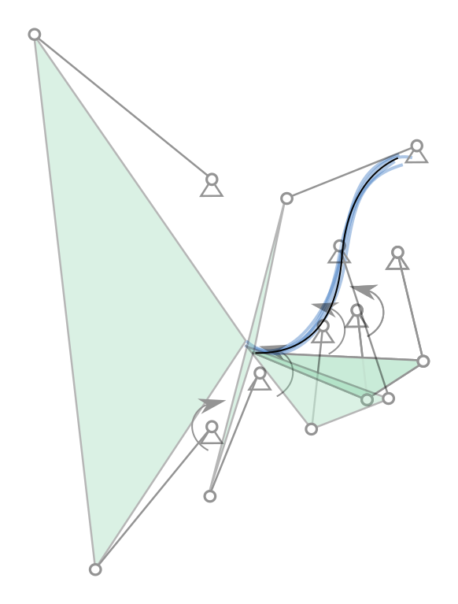
Deliverables of a
Concept Generator
Computational Creativity
Quantity beats Quality ?
Insight about the problem
How likely it is to find good solutions for this input?
Higher Level Assessment Task and Obtained Solutions
knowledge base that learns the connection of task and obtained solutions

Slide 15
Motion Generation : Classical Burmester Problem

Slide 16
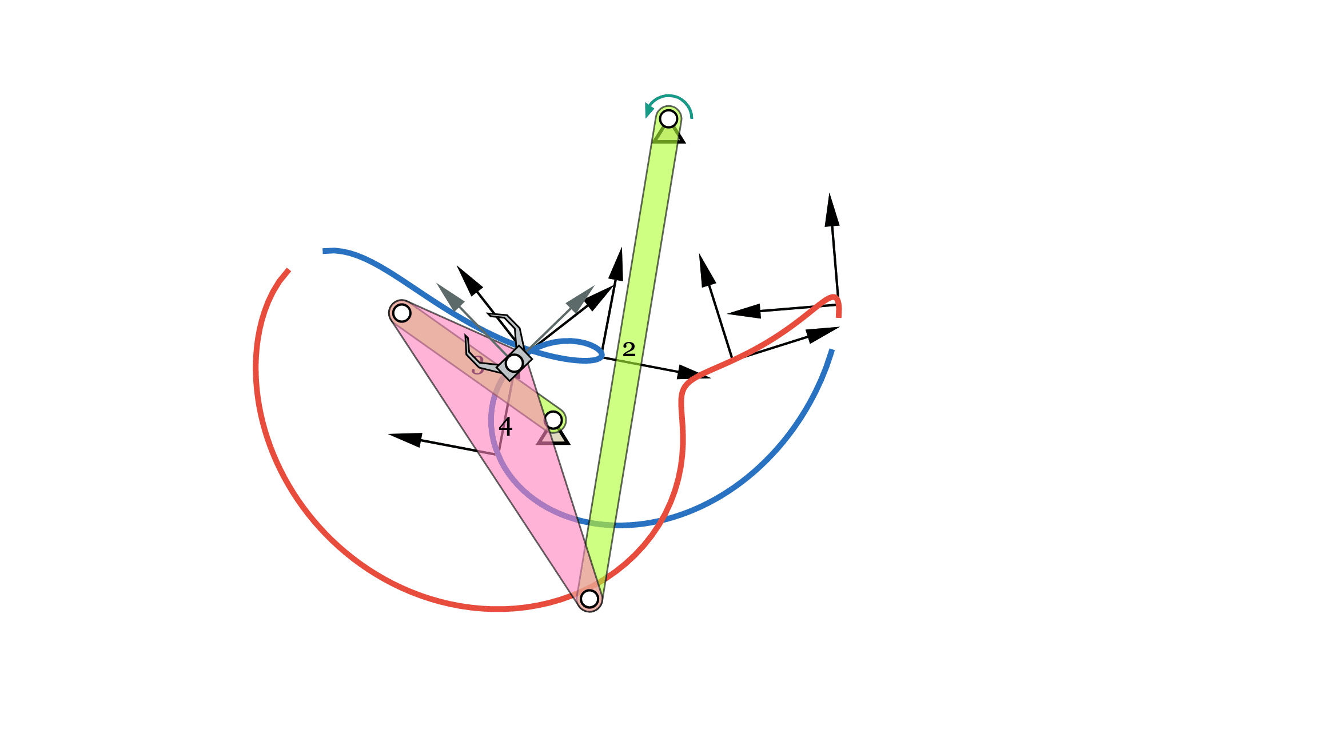
Motion Generation
Small Change in Input Renders Practically Useless Solution

Slide 17
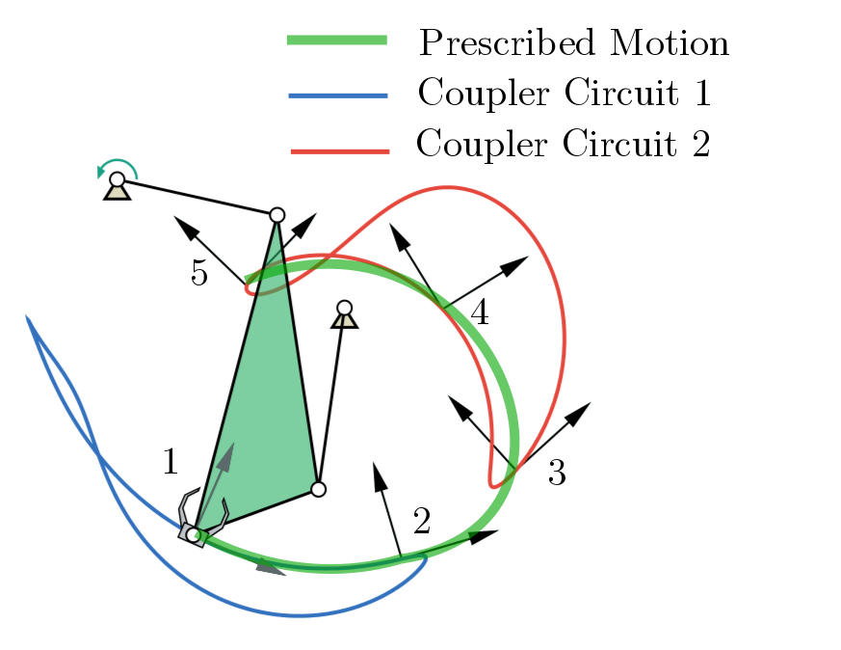
Precision Position vs Designer’s Intent
Notes:
Notion of Continuity is lost

Slide 18
Limitations of Precision Position Approach
Loss of Continuity Information => Defects in Linkage
Restrictive Objective
Mathematically Optimal Solution may not be practically optimal
discards a large proportion of numerically sub-optimal solutions with desirable properties

Slide 19
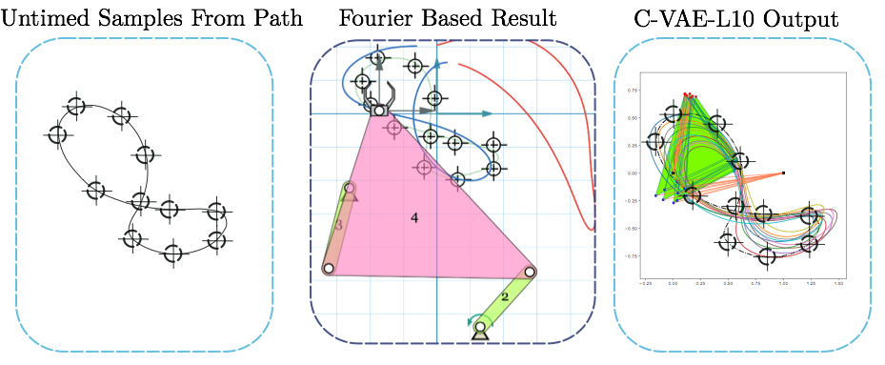
Path Generation

Slide 20
Limitations of Fourier Descriptor Approach
Only Defined for Four-Bar with Revolute Joints
Restrictive Objective
Mathematically Optimal Solution may not be practically optimal
discards a large proportion of numerically sub-optimal solutions with desirable properties

Slide 21
Need of Generative Model
Input Conditioning and Imputation requires capturing the underlying pattern
Learning joint probability distribution of linkage parameters
Generate Variational Inputs to exploit nonlinear nature of the problem

Slide 22
Variational Input
Common Approach is to change the input randomly within a tolerance range
Combinatorial Optimization (NP Hard)
Informed Modifications on Input
Requires knowledge about the properties of coupler motions (or paths) of planar linkages.

Slide 23
Variational Synthesis
Finding Solutions to Variational Input, Post processing of outputs to gather distinct solution concepts
Each concept is probability distribution of linkage parameters that pertain to same family of mechanisms

Slide 24
Generative Model
Variational Auto Encoder (VAE) and Conditional VAE (C-VAE)
Number of parameters significantly smaller than the amount of data we train them on
Models are forced to discover and efficiently internalize the essence of the data in order to generate it.
“What I cannot create, I do not understand.”
– Richard Feynman

Slide 25
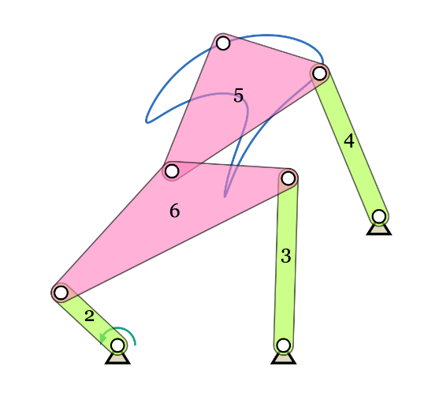
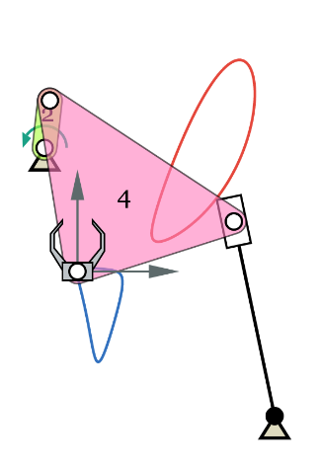
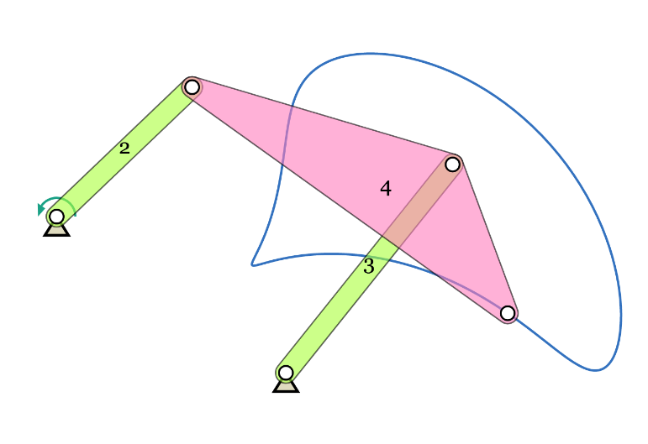
Representation Learning of Linkage Trajectories
Learn Salient Features of Linkage Trajectories
Given an unknown trajectory, recognize the potential linkage type.
Six-Bar Linkage
Four-R Linkage
Slider Crank Linkage

Slide 26
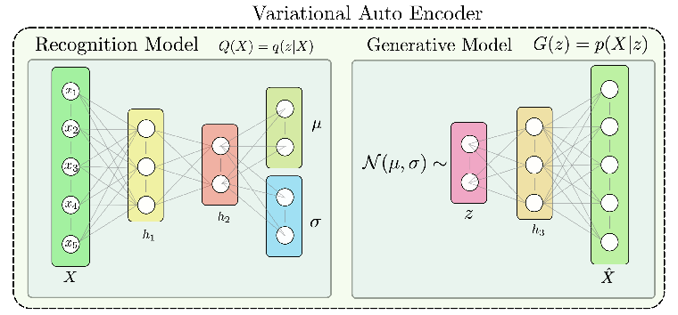
$$\text{Overserved Variable =}X$$
X can be Coupler Trajectories or Entire Linkage
X is Generated by a Natural Process, involving an unobserved continuous hidden variable z

Slide 27

VAE
Observed data is supposedly generated by an unknown function of continuous latent variables
We would like to infer these salient attributes z based on observed X,
Recognition Model approximates
$$X=G(z;θ_{g})$$
$$pr(z|X)=\frac{pr(X|z)pr(z)}{pr(X)},$$
Intractable
$$pr(z|X)$$
$$μ,σ=Q(X;θ_{e})$$
$$q(z|X)=N(μ,σ)$$

Slide 28
VAE
z is assumed to have a prior probability distribution
The training loss for VAE becomes,
Training Objective :
$$pr(z)=N(0,1)$$
$$L=\frac{1}{N}(L_{reconstruction}+L_{divergence})$$
$$L=\frac{1}{N}((\overset{̂}{X}-X)^{2}+β\overset{z_{dim}}{\underset{j}{∑}}KL(q_{j}(z|X)||p(z)))$$
$$θ_{e},θ_{g}=argmin\{\frac{1}{N}((\overset{̂}{X}-X)^{2}+β\overset{z_{dim}}{\underset{j}{∑}}KL(q_{j}(z|X)||p(z)))\}$$

Slide 29
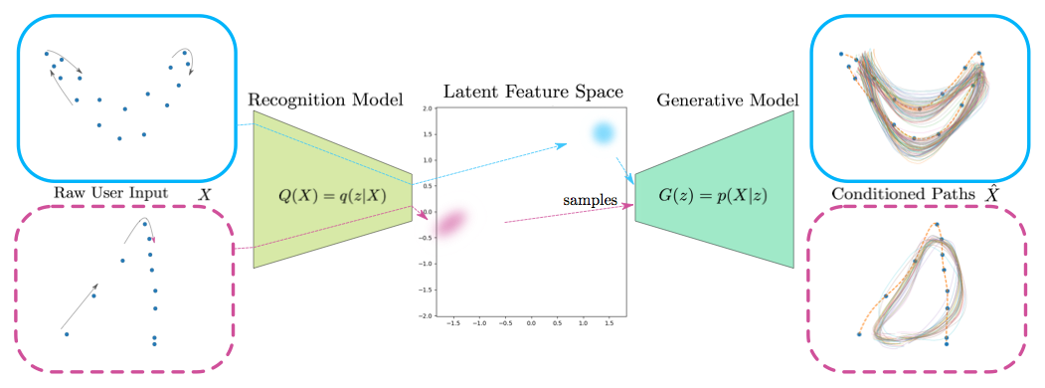
Input Recognition and Preconditioning

Slide 30
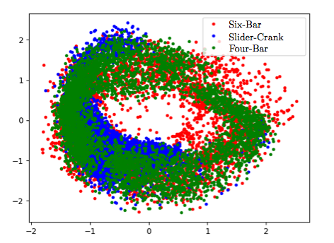
Motion Characterization in Latent Feature Space : Type Synthesis
Latent Embeddings of coupler motions sampled from random Fourbar, Sixbar and Slider Crank linkages
Notes:
Here, we can see that points clouds are overlapping. This overlapping concurs with the kinematic theory which says that some motions can be obtained from all of the overlapped mechanism types.
(This also is a good indicator that the learned latent space is in sync with the kinematic theory.)
I am stating this because people may think that good latent space embedding is the one where the data is separated.

Slide 31
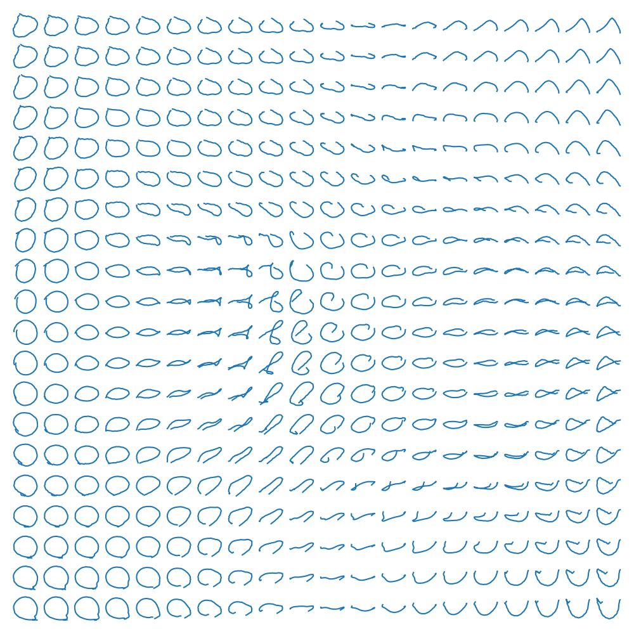
Paths Corresponding to Latent Embedding

Slide 32
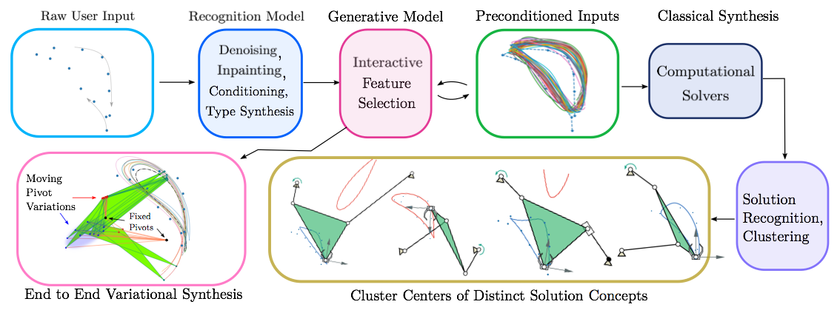
Variational Synthesis
Notes:
Preconditioning of the Input for Susceptible Solvers

Slide 33
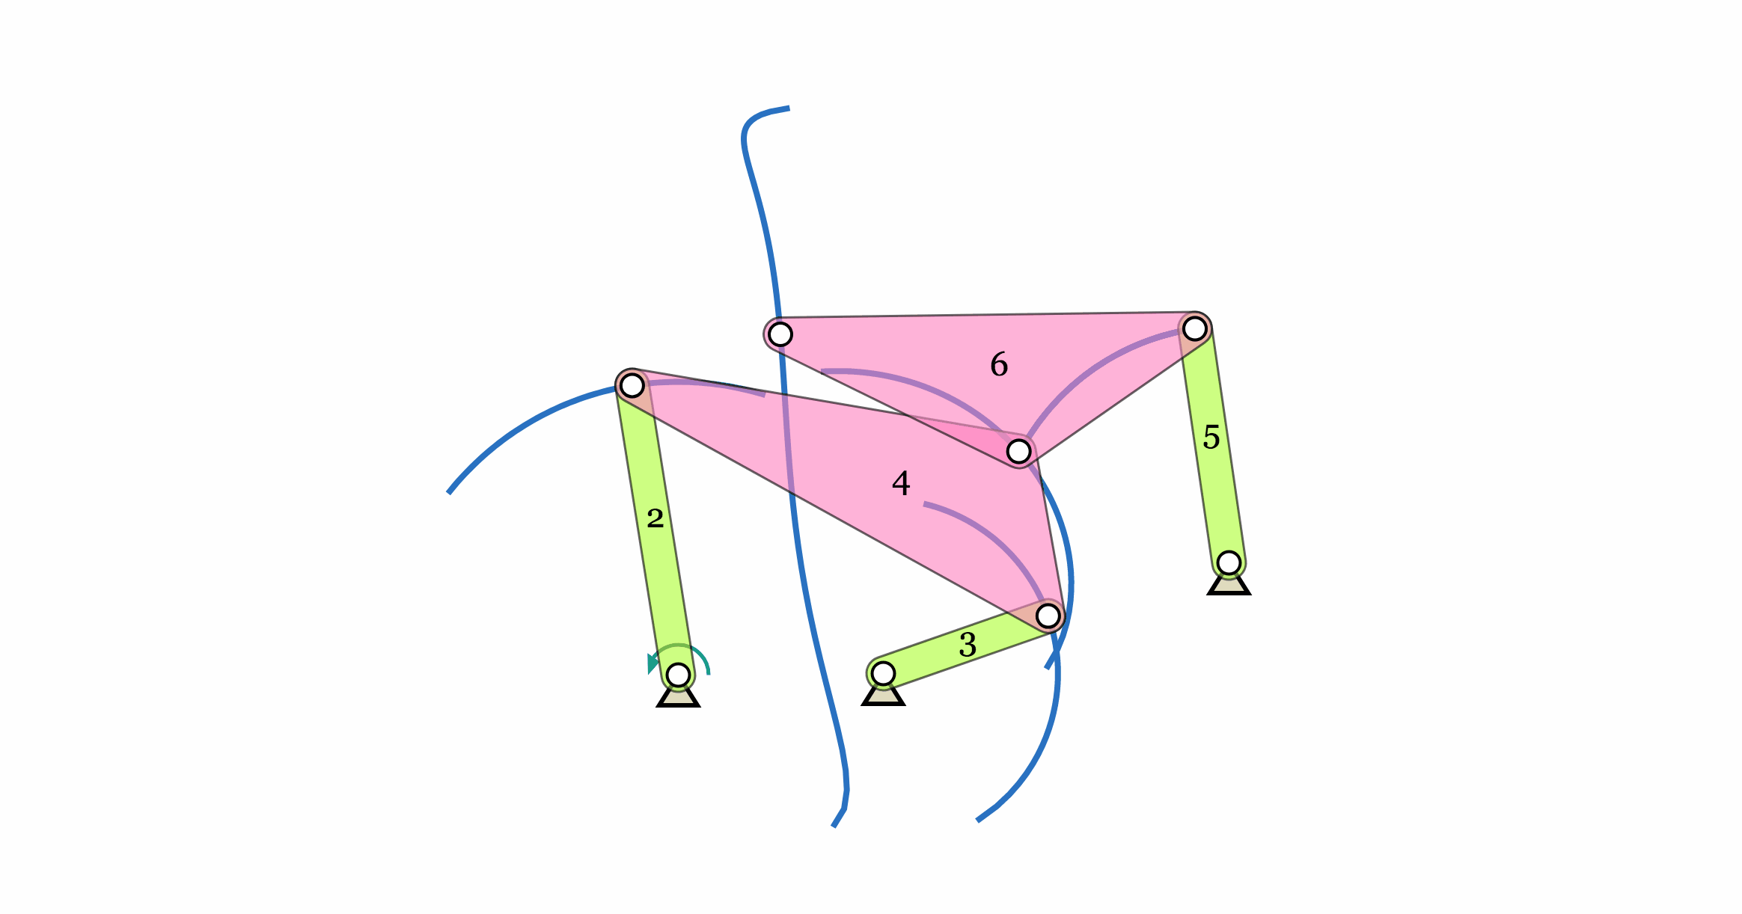
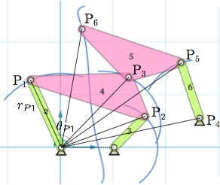
Linkage as Observed Variable (X)
$$X=\{r_{P1},θ_{P1},r_{P2},θ_{P2},r_{P3},θ_{Pl}\}_{i=1}^{100},$$

Slide 34
C-VAE
Observed data is supposedly generated by an unknown function G of continuous latent variables and a condition Y
Recognition Model approximates
C-VAE learns to model the conditional distribution of X and Y
$$X=G(z,Y;θ_{g})$$
$$μ,σ=Q(X,Y;θ_{e})$$
$$q(z|X)=N(μ,σ)$$

Slide 35
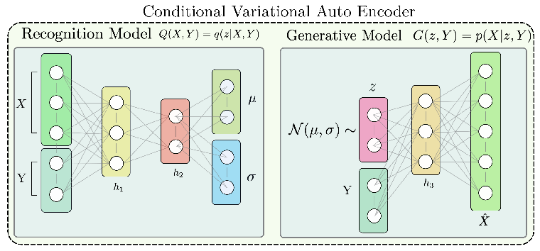

Slide 36
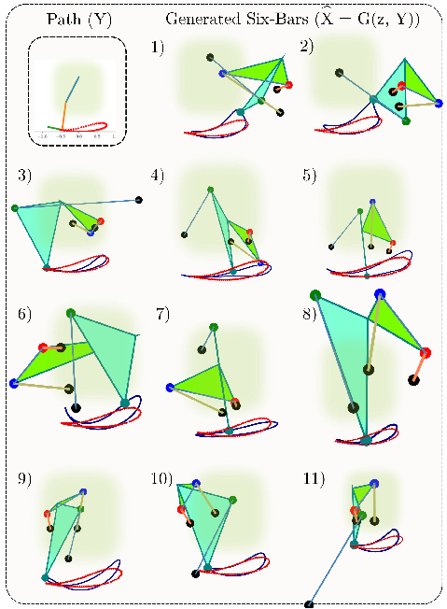

Slide 37
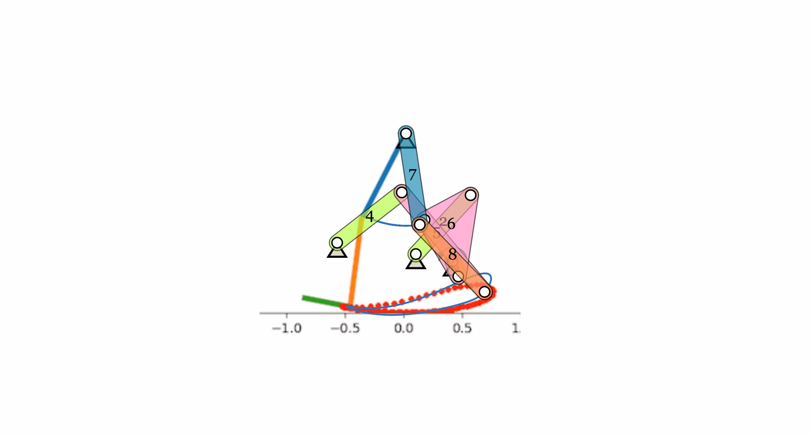
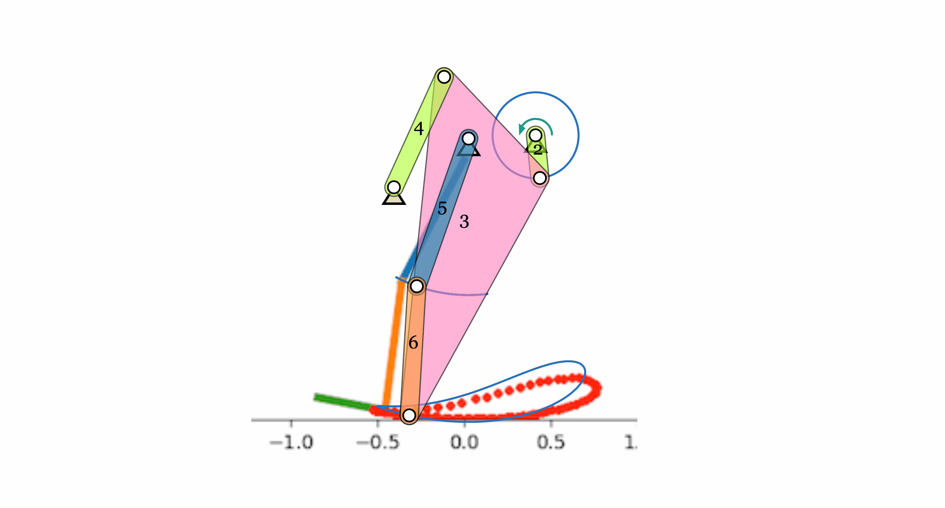
Designs for Gait Rehabilitation Device

Slide 38
Database Generation
Performance of ML based approaches highly depend on the dataset on which they are trained on
Balanced Data
Diverse Data Samples
Normalized Data

Slide 39
Database Generation
Curiosity Driven Exploration
State : Mechanism State
Action : Change in Linkage Parameters
Reward Model : Auto Encoder Reconstruction Loss
$$Q(X)=z$$
$$G(z)=\overset{̂}{X}$$
Encoder
Decoder
$$r=-\frac{1}{(G(Q(X_{t}))-X_{t})^{2}}$$
Reward for reaching State
$$X_{t}$$

Slide 40
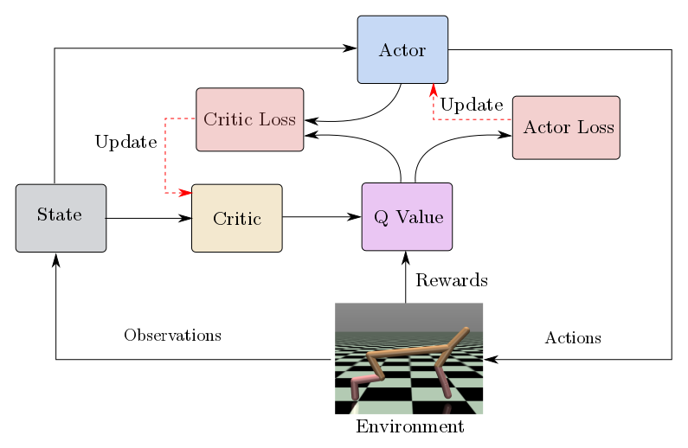
Database Generation with
Curiosity Driven Exploration
Deep Deterministic Policy Gradients (DDPG)

Slide 41
DDPG
Actor tries to approximate the best policy which maps a state to optimal action
Critic tries to approximate the predict the correct Q value
Critic is trained to Satisfy Bellman Equation
Actor is trained by policy gradients given by,
$$μ(θ^{μ}):s_{t}→a_{t}$$
$$Qc(θ^{Qc}):s_{t},a_{t}→Q$$
$$L(θ^{Qc})=(Qc-(r_{t}+γQ(s_{t+1},a_{t+1})^{π}))^{2},$$
$$\frac{δQc}{δθ^{μ}}=\frac{δQc}{δa}\frac{δa}{δθ^{μ}},$$

Slide 42
Things to Note
Synthesis Algorithms are combined with Deep Learning
To intelligently manage uncertainties and provide highly accurate distinct design solutions
A novel idea of an ML intermediary was introduced, which communicates between the user and computational algorithms.
Intelligently captures the user’s intention while managing the input for synthesis algorithms.
Interprets numerous solutions returned by the solver and provides the user with a distinct distribution of concept solutions.

Slide 43
Things to Note
This approach derives from the existing kinematic knowledge to create a new framework for mechanism synthesis
Solves problems that have had no good theoretical underpinning, such as defect-free generation, conditioning of the input, and contextual concept generation.
Deep learning was used to learn the meaningful representations of linkage parameters and used in a novel way to enhance the users’ design experience.

Slide 44
Next Steps
Data Representation
Architectural
Domain
Image Based Approach
Consistent data format for all planar mechanisms
Intuitive approach to apply constraints
Benefits of Data Bucketing
Leverage Established Deep Learning Architectures
GANs
Better Reconstruction Quality for Images
Attribute Vectors
Better Manipulation of Inputs
Attribute Vectors
Better Manipulation of Inputs
MultiDOF
Type Synthesis
Workspace Specification
Spatial Mechanisms
Scaling the approach in three dimensions

Slide 45

Image Based Approach
2D Array of Discretized Information
Specify Information in an Intuitive Way
lets you apply constraints which are hard to specify mathematically consistent manner
Ex. Restriction on Swept Volume

Slide 46
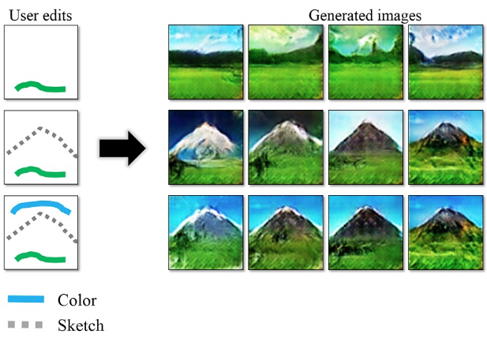
Image Based Approach
k-Channel Image
Each channel contains one aspect of information
Established Architectures like Generative Visual Manipulation can be used to perform Interactive Mechanism Design

Slide 47

Generative Manipulation on the Mechanism Image Manifold

Slide 48
Generative Manipulation on the Mechanism Image Manifold
Find Feature Vectors z, Based on User Input Recognition
Additional constraints can be used for local search in z space with following objective :
argmin
$$(L(z_{0},z)+c(z)+D(z))$$
$$z=$$
$$z$$
Distance from
$$z$$
Discriminator Loss
Pixelwise Constraint Loss

Slide 49
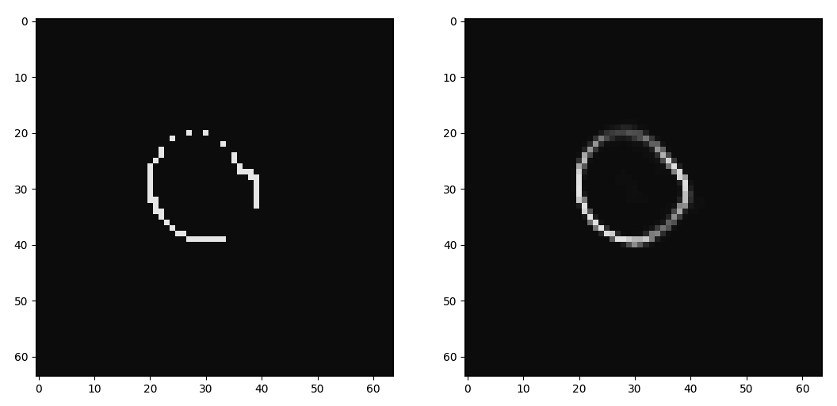
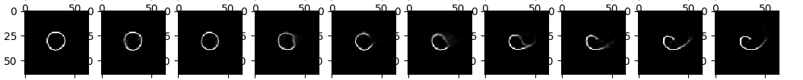
path-VEA Preliminary Results
Denoising + Inpainting
Shape Transformation
$$z_{1}$$
$$z=(t)z_{1}+(1-t)z_{2}$$
$$z_{2}$$

Slide 50
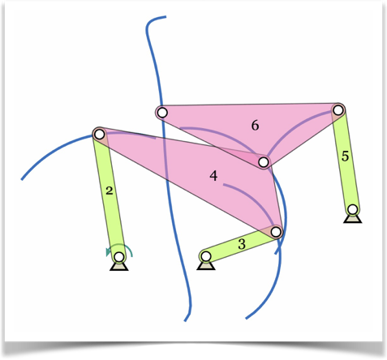
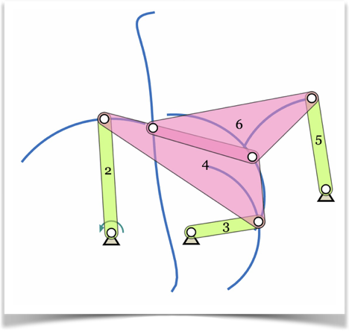
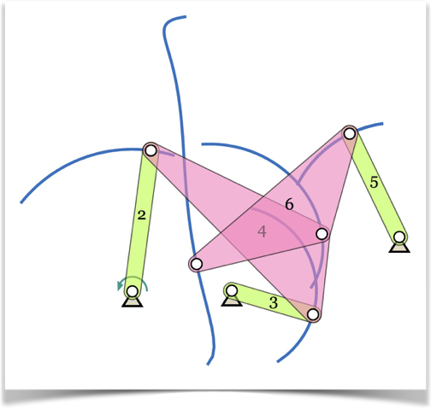
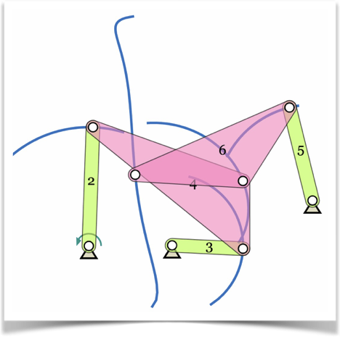
3D Images
Images can be stacked during entire simulation to form a 3D image containing rich information about mechanism
Interesting spatial and temporal patterns can be obtained
Timing related patterns (ex. Quick Return) for higher order linkages

Slide 51

Acknowledgment
A Computational Framework for Data-Driven Mechanism Design Innovation
(CMMI-1563413)

Slide 52
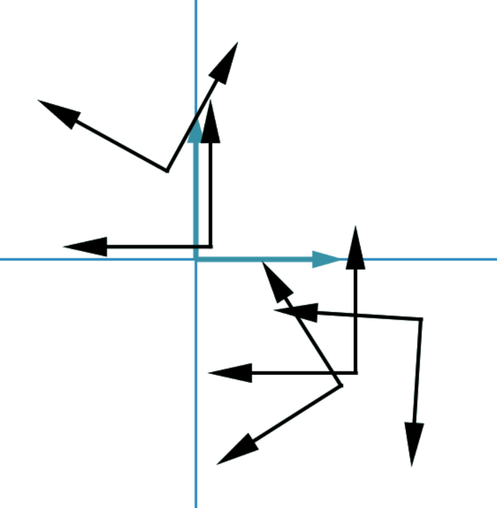
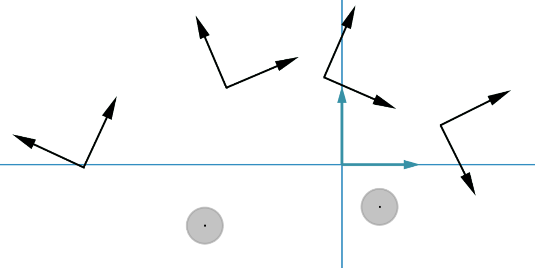
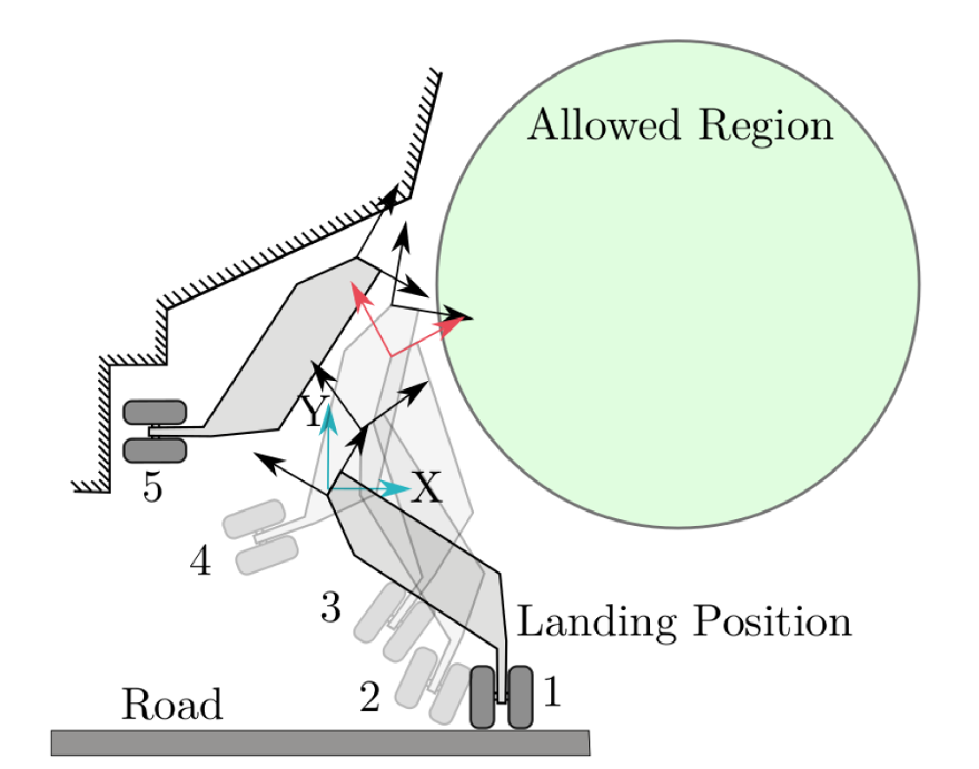
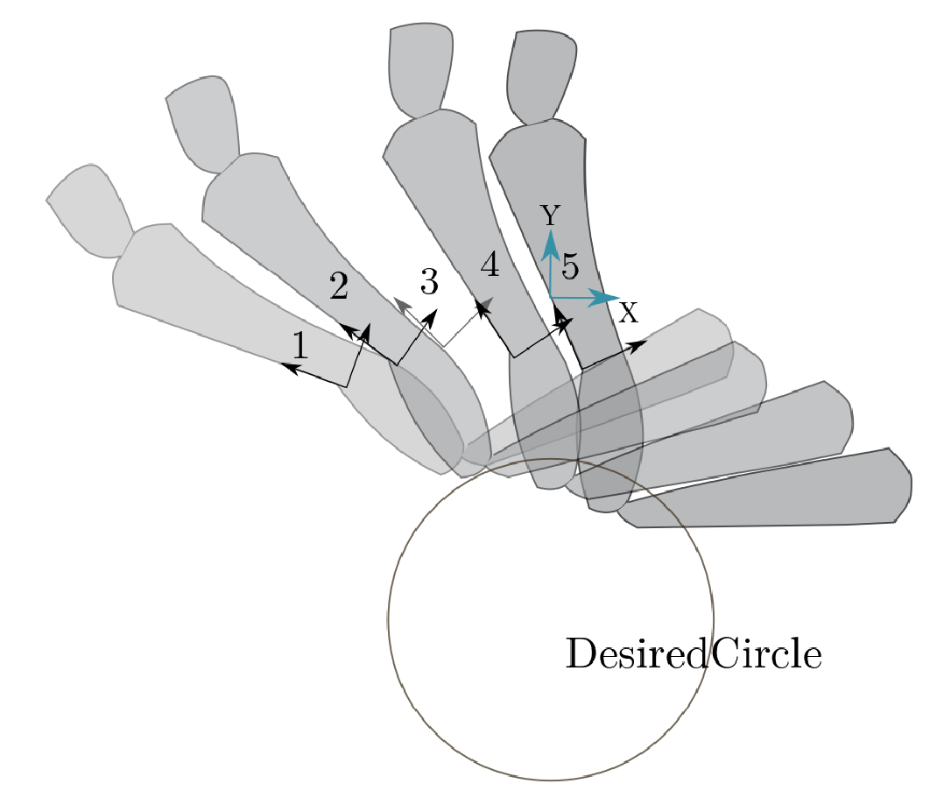
Extended Burmester Problems
No Solution

Slide 53
Extended Burmester Problem
Given n geometric constraints, determine the type and dimensions of all planar four-bar linkages consisting of revolute or prismatic joints.
Geometric Constraints can be on poses or pivots or something equivalent.
Geometric Constraints can be linear, non-linear, exact or approximate.
Includes finding answers to Burmester problem for which a solution may not exist.

Slide 54
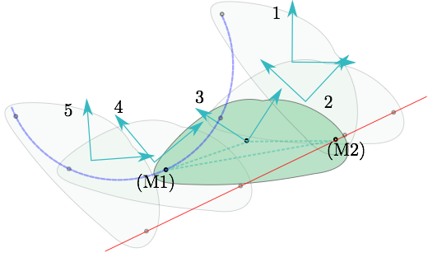
Finding a point that lies on Circle or Line

Slide 55
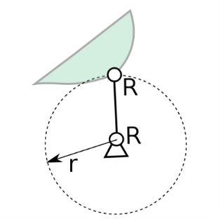
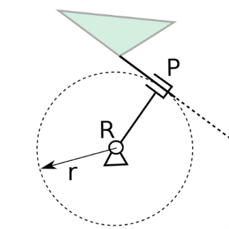
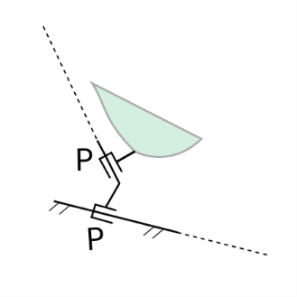
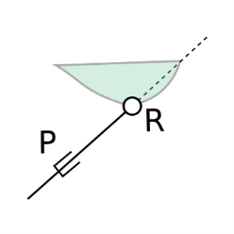
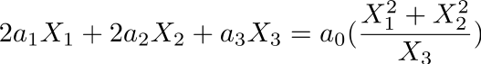
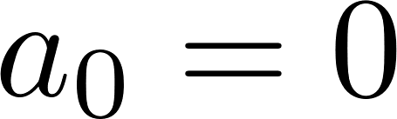
Review: Unified Representation of Dyad Constraints
A unified treatment of the geometric constraints of the building blocks (dyads for four-bar) of mechanisms
Homogeneous Representation of Line and Circle
when

Slide 56
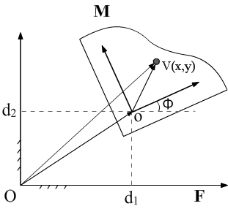
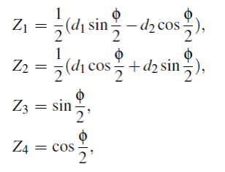
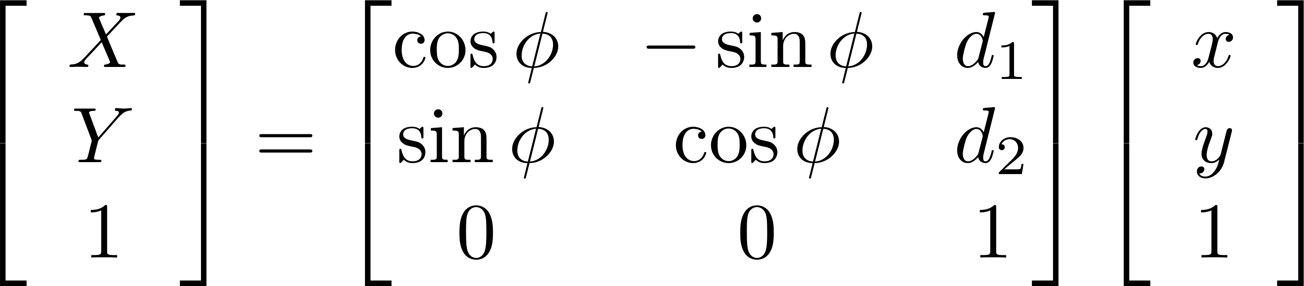
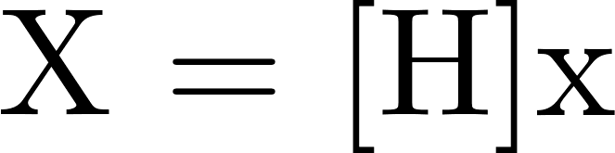
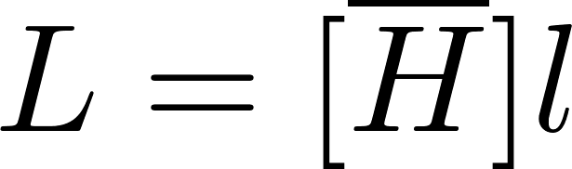
Planar-Quaternions and -Kinematic Mapping
Review: Image Space Approach

Slide 57
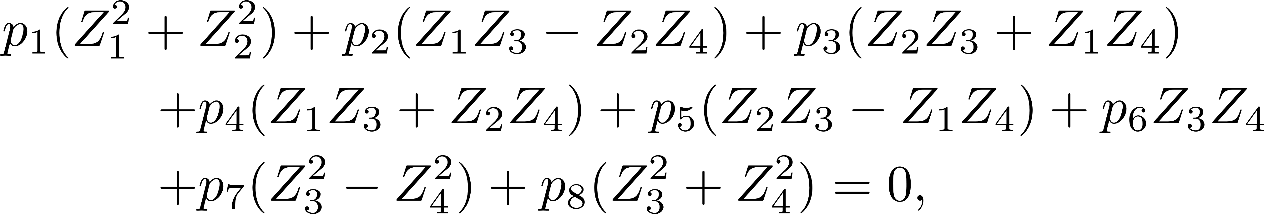
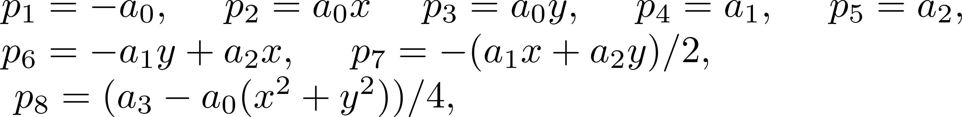
Constraints on Homogeneous Form
Above is defined by a set of 8 homogeneous coordinates (p₁...p₈)
However, there are only 5 independent mechanism parameters related by
There are two quadratic conditions on (p₁...p₈)

Slide 58
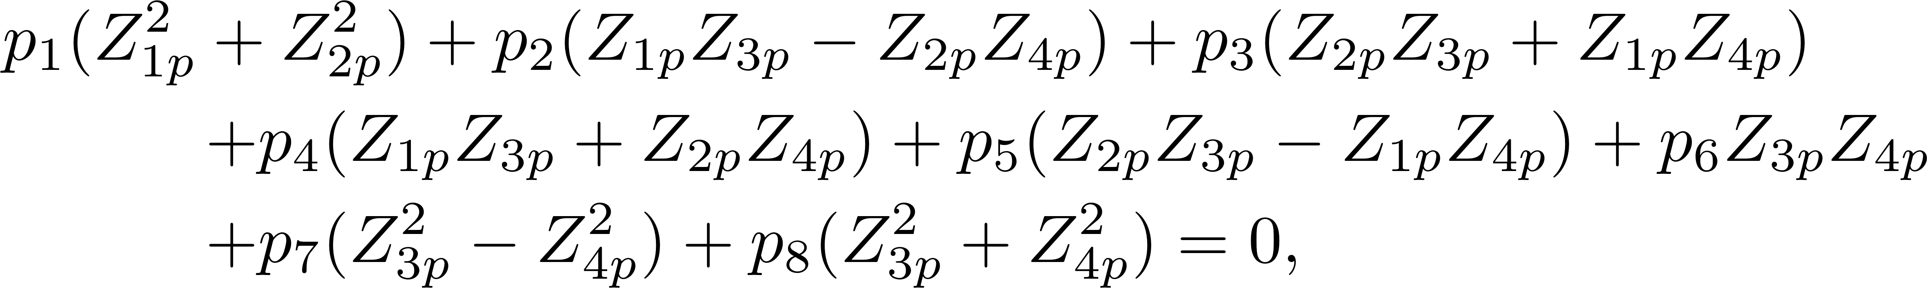
Geometric Constraints on Planar Mechanisms
Pose Constraint on Coupler

Slide 59
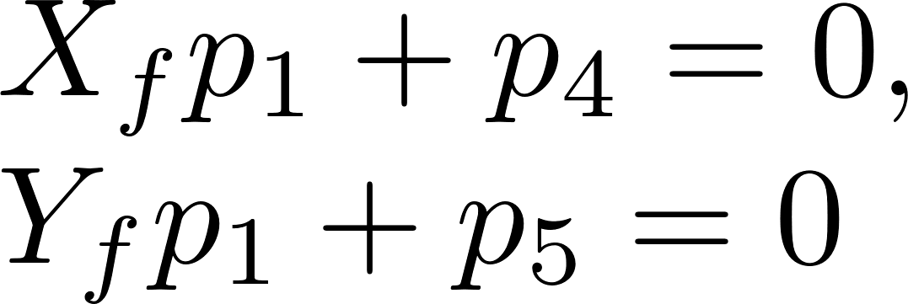

Geometric Constraints on Planar Mechanisms
Point Constraints on Fixed Pivots
Point Constraints on Moving Pivots

Slide 60


Geometric Constraints on Planar Mechanisms
Curve Constraints on Fixed Pivots
When
When

Slide 61


Linear Constraints in the Coefficient Space
Unified Form

Slide 62

Algebraic Fitting of Linear Constraints
We form a system of linear equations given by,
Singular Value Decomposition [A] = [U][S][V]^{T}
Null space formed by right singular vectors corresponding to zero singular value is the solution space for optimization given by

Slide 63
Constraints in the Null Space
Unified Linear Form
Candidate solution vector
Substitute p in the unified form of linear constraints
Substitute p in the non-linear constraint
To get

Slide 64
Constraints in the Null Space
Two quadratic Conditions
In the null space

Slide 65


Optimal Model
Minimize
where
while g is an inequality constraint.
Objective function represents algebraic fitting error of relaxed geometric constraints.

Slide 66
Minimization using Lagrange Multipliers
Lagrange Objective function is formed,
Taking partial derivative we form the system of polynomial equations given by,

Slide 67

Example : Landing Gear
Synthesize a four-bar linkage such that,
Mechanism passes through precision poses 1-2-4-5
Closely Approximates third pose
Fixed pivots desired to lie on or inside the allowed region.

Slide 68
Progressive Relaxation of Constraints
Five position synthesis to see if exact and useful solution exists
Relax third position and minimize its error function and check for useful solutions.
Add non-linear inequality constraint for circle

Slide 69

Solutions for Relaxed Third Pose
Six dyads obtained which in combination make up to 15 linkages.

Slide 70


Strict Circle Constraint
Three dyads with fixed pivots exactly on desired circle are obtained.
First Mechanism is Grashof crank-rocker Mechanism

Slide 71


Minimization with Inequality Constraint
Four dyads are obtained as a solution for minimization problem with inequality constraint.

Slide 72

Database Query Approach for Defect Free Linkage Synthesis
Notes:
Signature should be
1) invariant to similarity transformations
2) Capture the information related to shape of motion
3) Facilitate partial matching

